Slide 1
Thyroid Disease Detection

Slide 2
Objective:
Development of a robust machine learning system to predict thyroid diseases from patient data . The model will determine whether a patient has thyroid disease or not.
Benefits:
Detection of thyroid disease in patients.
Provide a user-friendly interface for data input and result visualization
Ensure stability.
Ease of deployment for future enhancements.

Slide 3
Data Sharing Agreement :
Sample file name (ex :Thyroid_Data)
Length of date stamp(8 digits)
Length of time stamp(6 digits)
Number of Columns (30)
Features: Age, sex, thyroid history, lab tests (TSH, T3, etc.), and other clinical indicators.

Slide 4
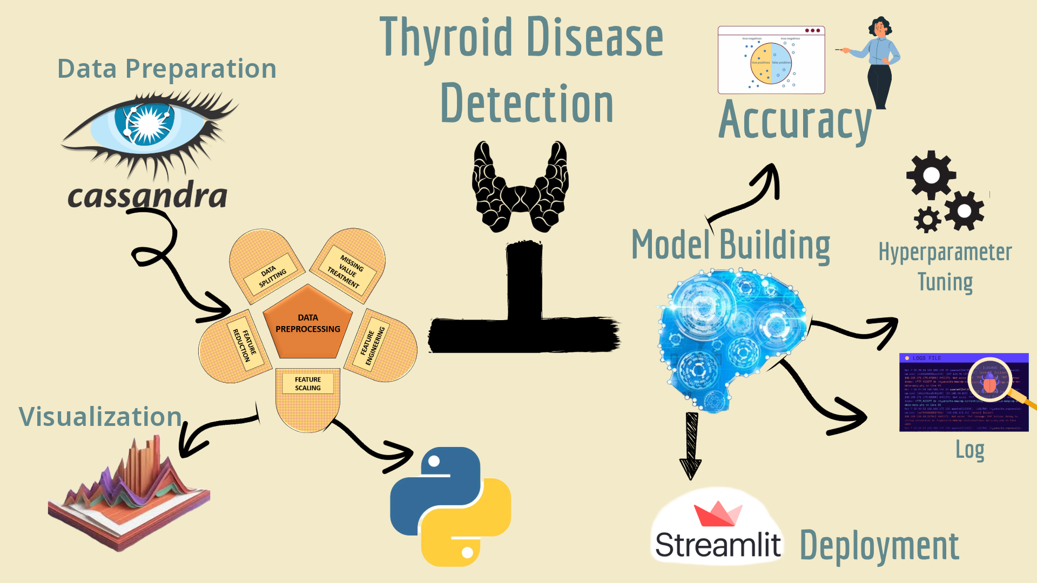
Architecture

Slide 5
Data Validation
Missing Values Check: Identifying missing or null values in the dataset, especially for key features like TSH, T3, TT4, T4U, and other medical attributes. Ensuring that essential features have valid values or imputing them if necessary.
Data Type Validation: Ensuring that each column has the correct data type (e.g., numerical, categorical) as expected by the model. For example, age should be numerical, while sex might be categorical.
Range and Threshold Checks: Verifying that the values are within realistic ranges (e.g., TSH levels should be within the range of typical thyroid tests). Any values outside the expected range may be flagged for further inspection or transformed appropriately.
Consistency Checks: Ensuring logical consistency, such as checking that features like pregnant and sex match (e.g., only females can be pregnant).

Slide 6
Data Transformation
Imputation: Filling missing values using techniques such as:
Mean, median, or mode imputation for continuous variables like TSH and T3.
Imputation based on medical knowledge or domain-specific logic for categorical variables.
Encoding Categorical Variables: Converting categorical variables, like sex and referral_source, into a numerical format using one-hot encoding or label encoding so they can be used in the Random Forest model.
Feature Scaling: Applying scaling techniques, such as StandardScaler or MinMaxScaler, on numerical features (e.g., TSH, TT4) to ensure they are on a similar scale. This helps in improving model performance and convergence.
Binary Transformation: Converting binary features (like on_thyroxine, pregnant, etc.) into 0s and 1s, which can be more easily interpreted by the model.
Outlier Removal or Treatment: Identifying and handling outliers, especially in key features such as TSH levels, which might skew the model’s understanding if not treated correctly.
Feature Engineering (if applicable): Creating new features or aggregating existing ones to improve model accuracy. For example, combining related features to create a composite index for thyroid function.

Slide 7
Model Training
Data Splitting:
The dataset was divided into training and testing sets to evaluate model performance. A common split ratio, such as 80% training and 20% testing, was used to ensure a reliable assessment of the model's predictive ability on unseen data.
Model Selection:
A Random Forest Classifier was chosen as the primary model due to its robustness, ability to handle complex relationships in the data, and its effectiveness with both numerical and categorical variables.
Hyperparameter Tuning:
To improve model accuracy and reduce overfitting, hyperparameter tuning was conducted. Parameters like the number of trees (n_estimators), maximum depth (max_depth), and minimum samples per leaf (min_samples_leaf) were optimized using techniques such as Grid Search or Random Search.
Cross-Validation:
k-fold cross-validation was used to validate the model performance more reliably by training and testing on different subsets of data. This helps ensure that the model generalizes well across different data splits.

Slide 8
Evaluation Metrics:
Metrics like accuracy, F1-score, precision, recall, and ROC-AUC were used to assess model performance,
especially given the potential class imbalance in thyroid disease classes (e.g., Hypothyroidism, Hyperthyroidism, Normal). These metrics help in understanding the model’s effectiveness in detecting each class.
Feature Importance Analysis:
The Random Forest model’s feature importance scores were examined to understand which features had the most significant impact on the model’s predictions. This provides insights into key medical indicators, helping validate the model’s reasoning and interpretability.
Model Iteration and Optimization:
The model was iteratively improved by adjusting preprocessing steps, handling imbalanced classes (if necessary), and fine-tuning the feature set. This iterative process ensured the model achieved optimal performance for accurate thyroid disease detection.
Saving the Trained Model:
The final model was saved using pickle or joblib for deployment, making it accessible to the Flask API and Streamlit application for real-time predictions.

Slide 9
The deployment process for the thyroid disease detection project includes:
Model Serialization: Save the trained Random Forest model using pickle or joblib for later use.
API Creation with Flask: Build a Flask API with an endpoint (e.g., /predict) to receive input data, load the model, and return predictions.
User Interface with Streamlit: Develop a Streamlit app for easy interaction, allowing users to upload data and view predictions in real-time.
Containerization with Docker (Optional): Use Docker to create a portable, consistent environment for the Flask API and Streamlit app.
Exposing the Application (Ngrok or Cloud): Use Ngrok for remote access in development or deploy on a cloud provider for production.
Monitoring and Maintenance: Implement logging and monitoring for error tracking and usage insights, possibly integrating with tools like Tableau.
CI/CD Pipeline: Set up a CI/CD pipeline for automated testing and deployment updates.

Slide 10
Conclusion
The Thyroid Disease Detection project provides a machine learning-based approach for identifying thyroid-related issues using patient data. With its scalable architecture, user-friendly interface, and flexible deployment options, the project is poised to be a valuable tool in the healthcare domain. Future iterations will focus on improving model accuracy, explainability, and scalability, while refining the user experience.

Slide 11
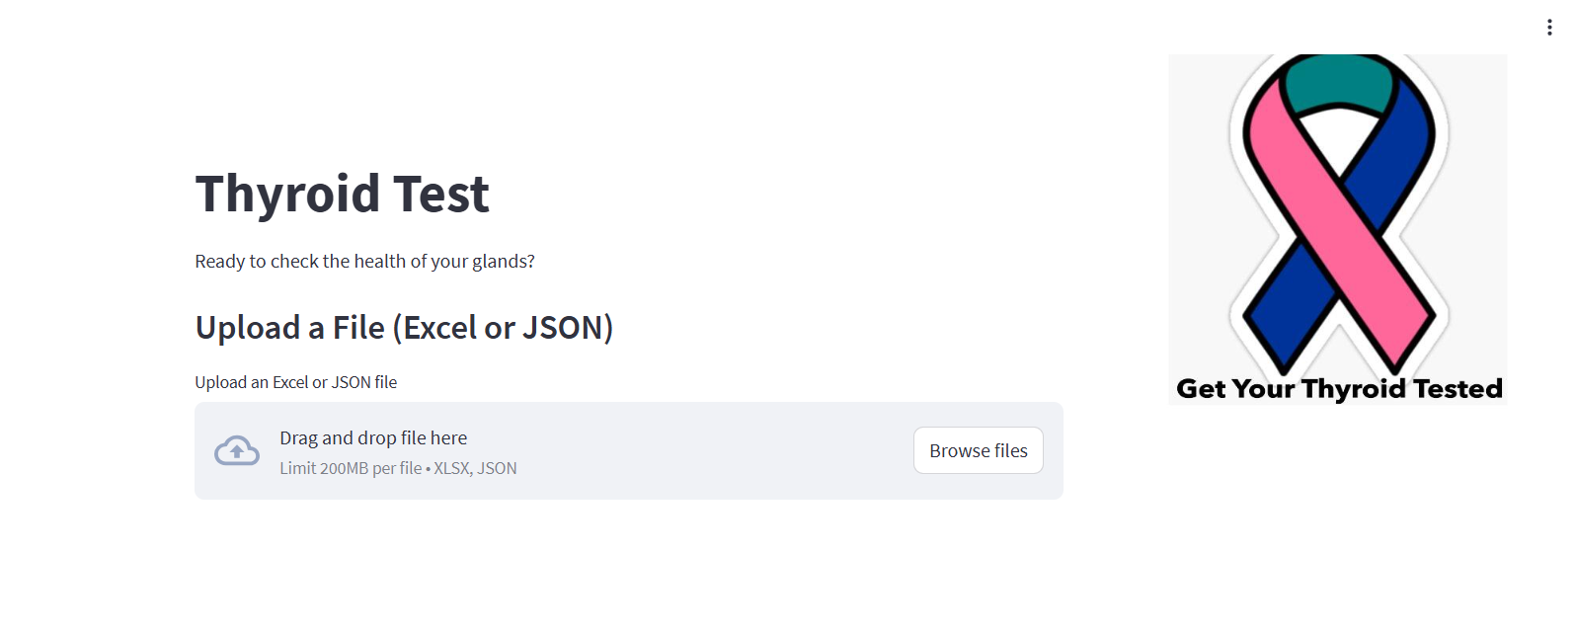

Slide 12
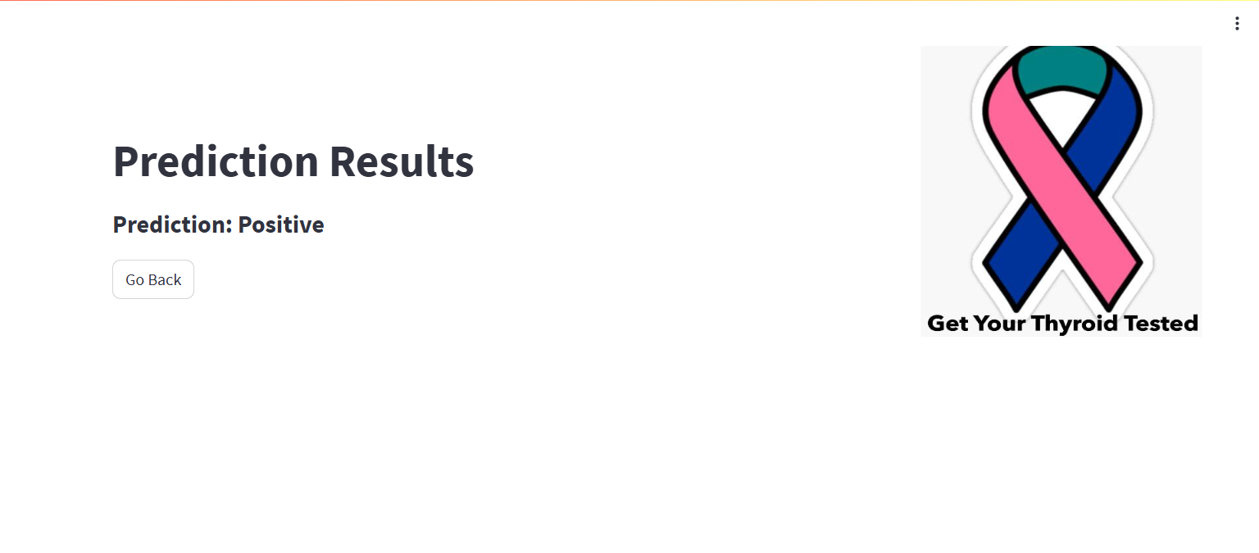

Slide 13


